Slide 1
Extending Kubernetes API
API Server, custom API and custom resources

Slide 2

Objectives
Understand how to extend Kubernetes API
Application of extensions
Look at real some world examples of extensions

Slide 3
Overview
Part 1
Part 2
Intro into API Server (core API and structure), discovery
Extending the API Server with a custom API
Accessing the API Server via client libraries
Metrics server overview
Custom Resource Definitions (CRDs)
CRD controllers
Kubernetes operator library
Using Helm

Slide 4
API Server
Provides (mostly) REST API.
Exceptions: health checks.
Communicates with ETCD
API server gives access to the Kubernetes resources
and non-resource objects.

Slide 5
Kubernetes resources
Objects managed by Kubernetes:
pods, services, deployments
From Kubernetes docs:
”A resource is an endpoint in the Kubernetes API that stores
a collection of API objects of a certain kind; for example, the built-in pods resource contains a collection
of Pod objects”

Slide 6
Kubernetes non-resource objects
Metrics
Logs

Slide 7
Requests to API Server
kubectl get pods –v 6
kubectl proxy
Kubectl get --raw

Slide 8
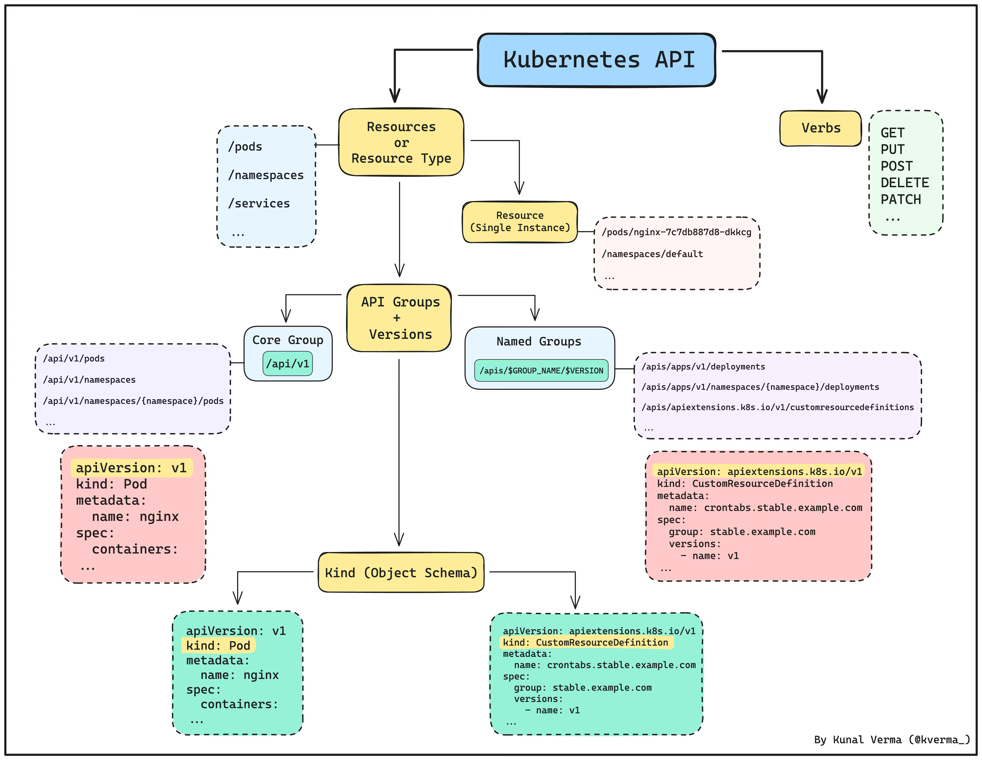
Kubernetes API structure

Slide 9
APIService
apiVersion: apiregistration.k8s.io/v1 kind: APIService metadata: name: v1alpha1.example.com spec: service: name: api-extension-server namespace: default group: example.com version: v1alpha1 insecureSkipTLSVerify: true groupPriorityMinimum: 1000 # Kubernetes uses this to resolve conflicts when multiple API groups serve the same resource. A higher value means higher priority. versionPriority: 15

Slide 10
Metrics server
kubectl create namespace metrics-server helm upgrade --install metrics-server metrics-server/metrics-server --set args="{--kubelet-insecure-tls}" -n metrics-server

Slide 11
Next steps
https://github.com/ybaryshnikova/extensions-meetup/blob/master/README.md
https://github.com/ybaryshnikova/extensions-meetup/tree/master/apiservice-example
Follow the metrics tutorial (link in references)

Slide 12
References
Kubernetes API guide
Kubernetes Python client custom API Working with Kubernetes API Series Metrics server tutorial

Slide 13
Questions?

